Slide 1
Chapter 4
SOAP: Simple Object Access Protocol
Mike P. Papazoglou
mikep@uvt.nl

Slide 2
Topics
Inter application communication
SOAP as a messaging protocol
Structure of a SOAP message
SOAP communication model
SOAP fault message
SOAP over HTTP
Advantages and disadvantages of SOAP

Slide 3
Inter-Application Communication
Conventional distributed applications use distributed communication technologies, e.g., CORBA, DCOM, Java/RMI, based on object RPC (ORPC) protocols that attempted to marry object orientation and network protocols.
  ORPC request is an identifier or symbolic name that the server could use to locate the target object inside the server process.
Weaknesses
  Both ends of the communication link would need to be implemented under the same distributed object model (Java/RMI or CORBA/IIOP)
  Difficulty of getting these protocols to work over firewalls or proxy servers, e.g, most firewalls are configured to allow hypertext transfer protocol (HTTP) to pass across, but not IIOP.
To address the problem of overcoming proprietary systems running on heterogeneous infrastructures, Web services rely on SOAP, an XML-based communication protocol for exchanging messages between computers regardless of their operating systems, programming environment or object model framework.

Slide 4
Topics
Inter application communication
SOAP as a messaging protocol
Structure of a SOAP message
SOAP communication model
SOAP fault message
SOAP over HTTP
Advantages and disadvantages of SOAP

Slide 5
What is SOAP?
SOAP is the standard messaging protocol used by Web services. SOAP’s primary application is inter application communication. SOAP codifies the use of XML as an encoding scheme for request and response parameters using HTTP as a means for transport.
Service requestor
Service provider
Application object
(client)
Application object
(service provider)
SOAP-based middleware
SOAP-based middleware
SOAP messages exchanged on top of, HTTP, SMTP, or other transport
Converts procedure calls to/from XML messages sent through HTTP or other protocols.

Slide 6
What is SOAP? (continued)
SOAP covers the following four main areas:
  A message format for one-way communication describing how a message can be packed into an XML document.
  A description of how a SOAP message should be transported using HTTP (for Web-based interaction) or SMTP (for e-mail-based interaction).
  A set of rules that must be followed when processing a SOAP message and a simple classification of the entities involved in processing a SOAP message.
  A set of conventions on how to turn an RPC call into a SOAP message and back.

Slide 7
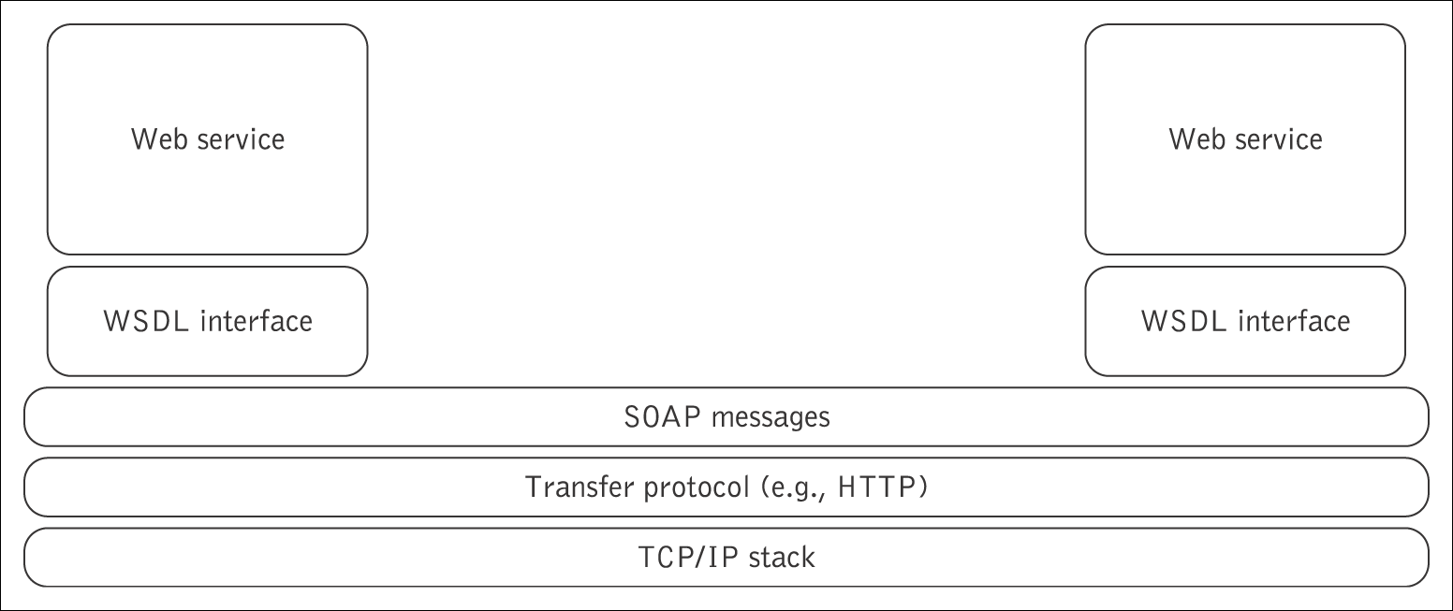
SOAP as a lightweight protocol
SOAP is a lightweight protocol that allows applications to pass messages and data back and forth between disparate systems in a distributed environment enabling remote method invocation.
By lightweight we mean that the SOAP protocol possesses only two fundamental properties. It can:
  send and receive HTTP (or other) transport protocol packets, and
  process XML messages.
This can be contrasted with the heavyweight protocols such as ORPC protocols.

Slide 8
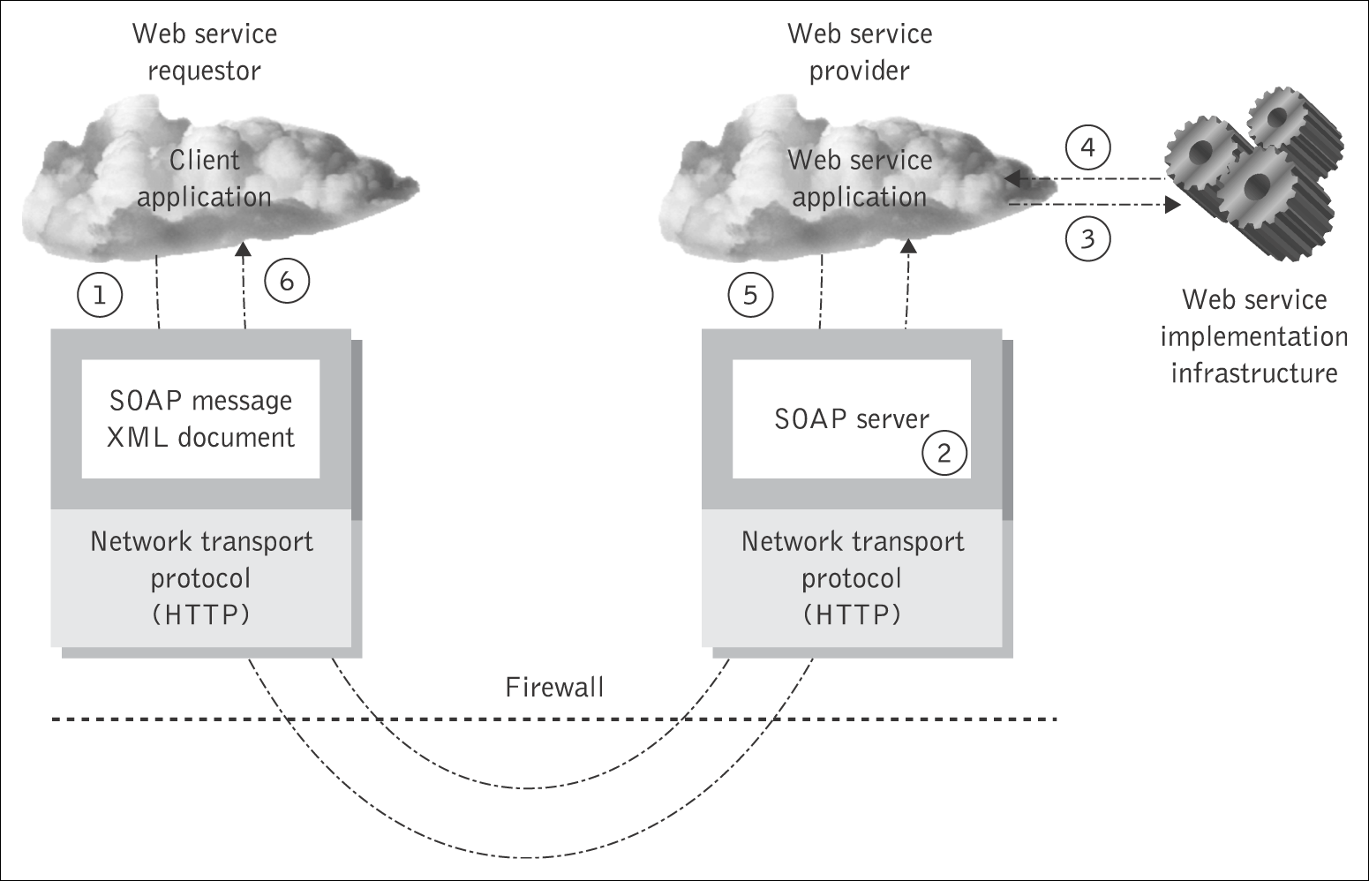
Distributed messaging using SOAP

Slide 9
Topics
Inter application communication
SOAP as a messaging protocol
Structure of a SOAP message
SOAP communication model
SOAP fault message
SOAP over HTTP
Advantages and disadvantages of SOAP

Slide 10
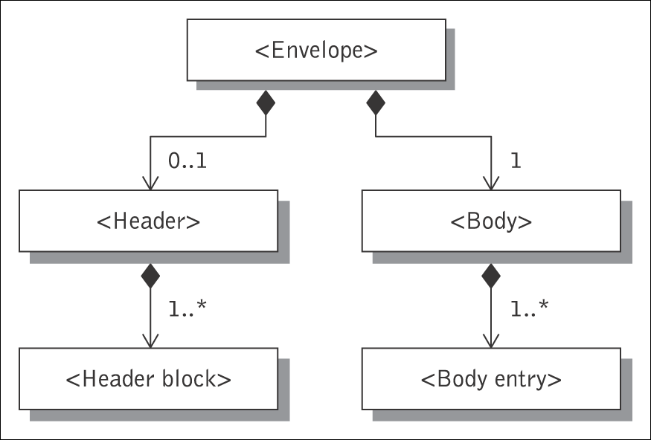
SOAP messages
SOAP is based on message exchanges.
Messages are seen as envelopes where the application encloses the data to be sent.
A SOAP message consists of a SOAP of an <Envelope> element containing an optional <Header> and a mandatory <Body> element.
The contents of these elements are application defined and not a part of the SOAP specifications.
A SOAP <Header> contains blocks of information relevant to how the message is to be processed. This helps pass information in SOAP messages that is not application payload.
The SOAP <Body> is where the main end-to-end information conveyed in a SOAP message must be carried.
SOAP envelope
SOAP header
header block
SOAP body
body block

Slide 11
SOAP envelope and header
<env:Envelope
xmlns:env=“http://www.w3.org/2003/05/soap-envelope”
env:encodingStyle=”http://schemas.xmlsoap.org/soap/encoding/”>
……
</env:Envelope>
Example of SOAP envelope
<env:Envelope
xmlns:env=“http://www.w3.org/2003/05/soap-envelope” >
…
<env:Header>
<tx:transaction-id
xmlns:tx=”http://www.transaction.com/transaction”
env:mustUnderstand=”true”>
512
</tx:transaction-id>
<notary:token xmlns:notary=”http://www.notarization-services.com/token”
env:mustUnderstand=”true”>
GRAAL-5YF3
</notary:token>
</env:Header>
……………
</env:Envelope>
Example of SOAP header

Slide 12
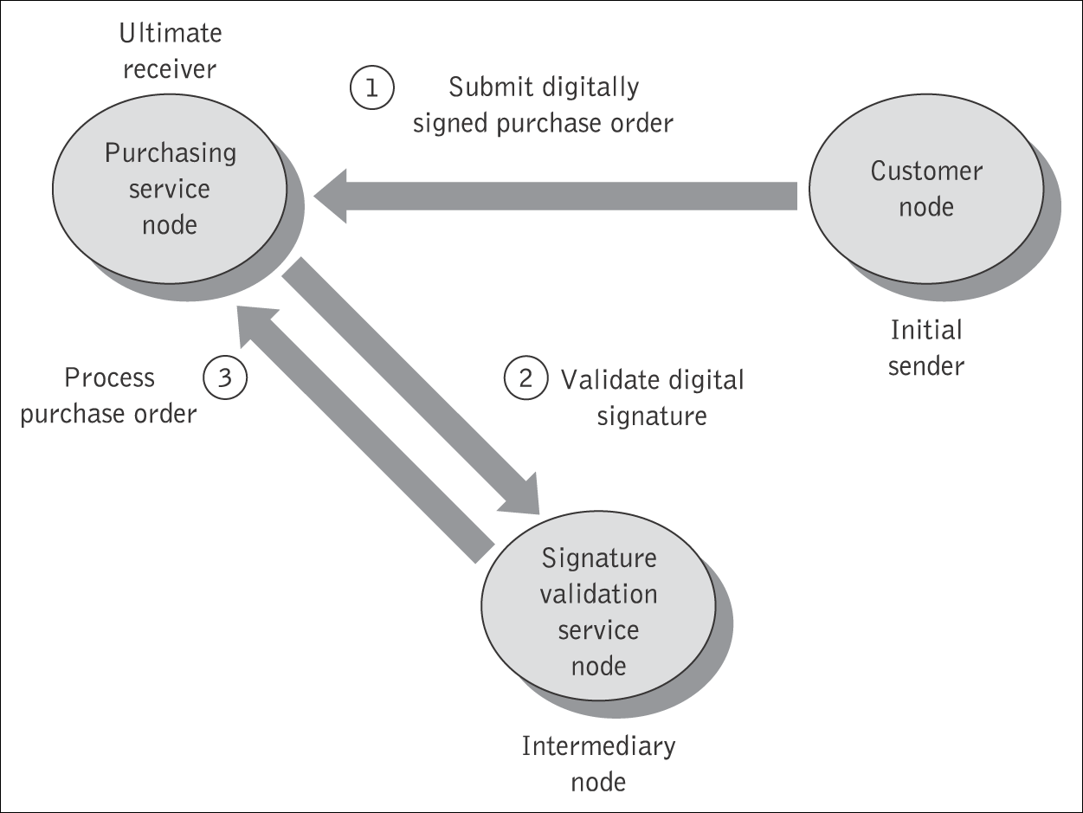
SOAP Intermediaries
SOAP headers have been designed in anticipation of participation of other SOAP processing nodes – called SOAP intermediaries – along a message's path from an initial SOAP sender to an ultimate SOAP receiver.
A SOAP message travels along the message path from a sender to a receiver.
All SOAP messages start with an initial sender, which creates the SOAP message, and end with an ultimate receiver.

Slide 13
Example of SOAP header with message routing
<?xml version="1.0" encoding="UTF-8"?>
<env:Envelope
xmlns:env=“http://www.w3.org/2003/05/soap-envelope”>
<env:Header>
<m:order
xmlns:m="http://www.plastics_supply.com/purchase-order"
env:role="http://www.w3.org/2003/05/soap-envelope/role/next"
env:mustUnderstand="true">
<m:order-no >uuid:0411a2daa</m:order-no>
<m:date>2004-11-8</m:date>
</m:order>
<n:customer xmlns:n="http://www.supply.com/customers"
env:role="http://www.w3.org/2003/05/soap-envelope/role/next"
env:mustUnderstand="true">
<n:name> Marvin Sanders </n:name>
</n:customer >
</env:Header>
<env:Body>
<-- Payload element goes here -->
</env:Body>
</env:Envelope>

Slide 14
The SOAP Body
The SOAP body is the area of the SOAP message, where the application specific XML data (payload) being exchanged in the message is placed.
The <Body> element must be present and is an immediate child of the envelope. It may contain a number of child elements, called body entries, but it may also be empty. The <Body> element contains either of the following:
  Application-specific data is the information that is exchanged with a Web service. The SOAP <Body> is where the method call information and its related arguments are encoded. It is where the response to a method call is placed, and where error information can be stored.
  A fault message is used only when an error occurs.
A SOAP message may carry either application-specific data or a fault, but not both.

Slide 15
Example SOAP Message
<?xml version='1.0' ?>
<env:Envelope xmlns:env="http://www.w3.org/2002/06/soap-envelope" >
<env:Header>
<t:transactionID
xmlns:t="http://intermediary.example.com/procurement"
env:role="http://www.w3.org/2002/06/soap-envelope/role/next"
env:mustUnderstand="true" >
57539
</t:transactionID>
</env:Header>
<env:Body>
<m:orderGoods
env:encodingStyle="http://www.w3.org/2002/06/soap-encoding"
xmlns:m="http://example.com/procurement">
<m:productItem>
<name>ACME Softener</name>
</m:productItem>
<m:quantity>
35
</m:quantity>
</m:orderGoods>
</env:Body>
</env:Envelope>
Envelope
Header
Blocks
Body

Slide 16
Topics
Inter application communication
SOAP as a messaging protocol
Structure of a SOAP message
SOAP communication model
SOAP fault message
SOAP over HTTP
Advantages and disadvantages of SOAP

Slide 17
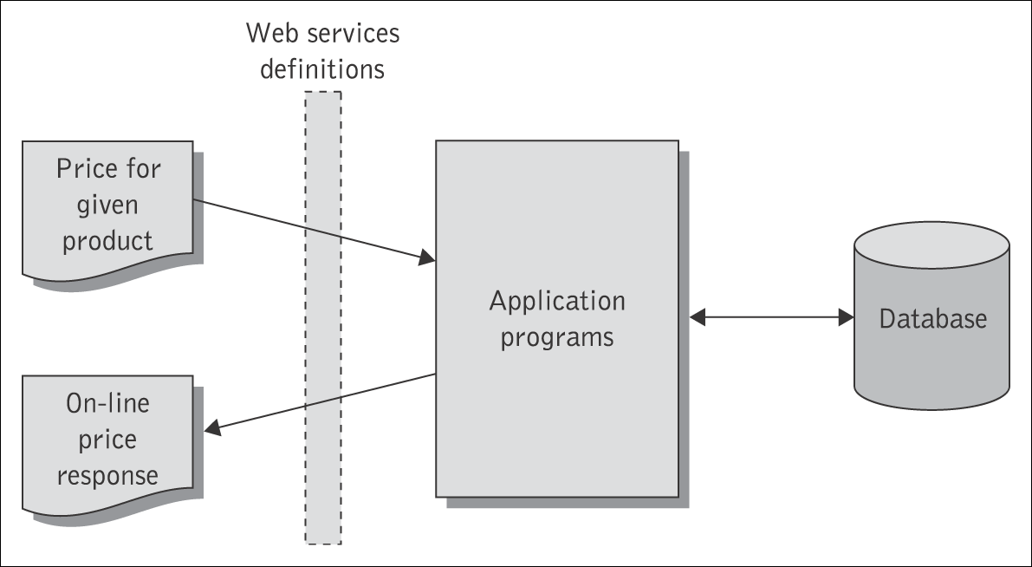
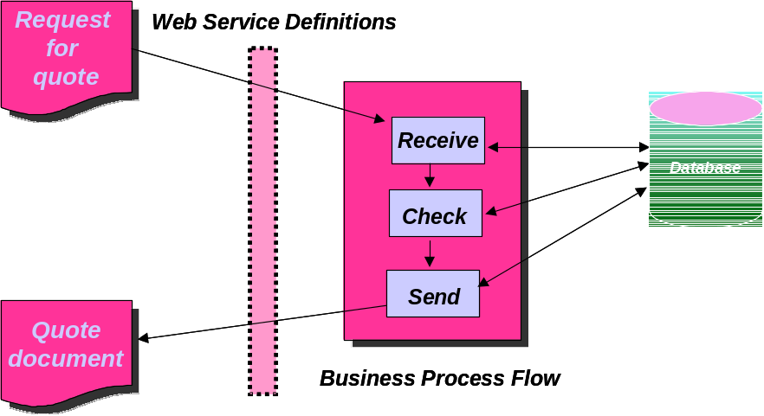
The SOAP Communication Model
SOAP supports two possible communication styles:
  remote procedure call (RPC) and
  document (or message).
RPC-style interaction
Document-style interaction

Slide 18
RPC-style SOAP Services
A remote procedure call (RPC)-style Web service appears as a remote object to a client application. The interaction between a client and an RPC-style Web service centers around a service-specific interface. Clients express their request as a method call with a set of arguments, which returns a response containing a return value.
SOAP envelope
SOAP envelope
SOAP body
SOAP body
Method name
orderGoods
Method return
Input parameter 1
product item
Return value
order id
Input parameter 2
quantity

Slide 19
RPC-style web services
<env:Envelope
xmlns:SOAP=“http://www.w3.org/2003/05/soap-envelope”
xmlns:m="http://www.plastics_supply.com/product-prices">
<env:Header>
<tx:Transaction-id
xmlns:t=”http://www.transaction.com/transactions”
env:mustUnderstand='1'>
512
</tx:Transaction-id>
</env:Header>
<env:Body>
<m:GetProductPrice>
<product-id> 450R6OP </product-id >
</m:GetProductPrice >
</env:Body>
</env:Envelope>
Example of RPC-style SOAP body
<env:Envelope
xmlns:SOAP=“http://www.w3.org/2003/05/soap-envelope”
xmlns:m="http://www.plastics_supply.com/product-prices">
<env:Header>
<--! – Optional context information -->
</env:Header>
<env:Body>
<m:GetProductPriceResponse>
<product-price> 134.32 </product-price>
</m:GetProductPriceResponse>
</env:Body>
</env:Envelope>
Example of RPC-style SOAP response message

Slide 20
Document (Message)-style SOAP Services
In the document-style of messaging, the SOAP <Body> contains an XML document fragment. The <Body> element reflects no explicit XML structure.
The SOAP run-time environment accepts the SOAP <Body> element as it stands and hands it over to the application it is destined for unchanged. There may or may not be a response associated with this message.
SOAP envelope
SOAP envelope
SOAP body
SOAP body
PurchaseOrder
document
product item
quantity
Acknowledgement
document
order id

Slide 21
Example of document-style SOAP body
<env:Envelope
xmlns:SOAP=“http://www.w3.org/2003/05/soap-envelope”>
<env:Header>
<tx:Transaction-id
xmlns:t=”http://www.transaction.com/transactions”
env:mustUnderstand='1'>
512
</env:Header>
<env:Body>
<po:PurchaseOrder oderDate=”2004-12-02”
xmlns:m="http://www.plastics_supply.com/POs">
<po:from>
<po:accountName> RightPlastics </po:accountName>
<po:accountNumber> PSC-0343-02 </po:accountNumber>
</po:from>
<po:to>
<po:supplierName> Plastic Supplies Inc. </po:supplierName>
<po:supplierAddress> Yara Valley Melbourne </po:supplierAddress>
</po:to>
<po:product>
<po:product-name> injection molder </po:product-name>
<po:product-model> G-100T </po:product-model>
<po:quantity> 2 </po:quantity>
</po:product>
</ po:PurchaseOrder >
</env:Body>
</env:Envelope>
Example of document-style SOAP body

Slide 22
Topics
Inter application communication
SOAP as a messaging protocol
Structure of a SOAP message
SOAP communication model
SOAP fault message
SOAP over HTTP
Advantages and disadvantages of SOAP

Slide 23
SOAP Fault element
SOAP provides a model for handling faults arise.
It distinguishes between the conditions that result in a fault, and the ability to signal that fault to the originator of the faulty message or another node. The SOAP <Body> is the place where fault information is placed.
<env:Envelope
xmlns:SOAP=“http://www.w3.org/2003/05/soap-envelope”
xmlns:m="http://www.plastics_supply.com/product-prices">
<env:Header>
<tx:Transaction-id
xmlns:t=”http://www.transaction.com/transactions”
env:mustUnderstand='1'>
512
</tx:Transaction-id>
</env:Header>
<env:Body>
<env:Fault>
<env:Code>
<env:Value>env:Sender</env:Value>
<env:Subcode>
<env:Value> m:InvalidPurchaseOrder </env:Value>
</env:Subcode>
</env:Code>
<env:Reason>
<env:Text xml:lang="en-UK"> Specified product did not exist </env:Text>
</env:Reason>
<env:Detail>
<err:myFaultDetails
xmlns:err="http://www.plastics_supply.com/faults">
<err:message> Product number contains invalid characters </err:message>
<err:errorcode> 129 </err:errorcode>
</err:myFaultDetails>
</env:Detail>
</env:Fault>
</env:Body>
</env:Envelope>

Slide 24
Topics
Inter application communication
SOAP as a messaging protocol
Structure of a SOAP message
SOAP communication model
SOAP fault message
SOAP over HTTP
Advantages and disadvantages of SOAP

Slide 25
SOAP and HTTP
A binding of SOAP to a transport protocol is a description of how a SOAP message is to be sent using that transport protocol.
The typical binding for SOAP is HTTP.
SOAP can use GET or POST. With GET, the request is not a SOAP message but the response is a SOAP message, with POST both request and response are SOAP messages (in version 1.2, version 1.1 mainly considers the use of POST).
SOAP uses the same error and status codes as those used in HTTP so that HTTP responses can be directly interpreted by a SOAP module.
HTTP POST
SOAP envelope
SOAP header
Transactional
context
SOAP body
Name of procedure
Input parameter 1
Input parameter 2

Slide 26
RPC call using SOAP over HTTP
HTTP Post
SOAP envelope
SOAP header
Transactional
context
SOAP body
Name of the
Service requestor
procedure
Service provider
Input parameter 1
SOAP engine
HTTP engine
HTTP engine
SOAP engine
Input parameter 2
Client implementation (other tiers)
HTTP Post
Service implementation (other tiers)
SOAP envelope
SOAP envelope
SOAP header
SOAP header
transactional
Transactional
context
context
SOAP body
SOAP body
return
Return
parameter
parameter

Slide 27
Topics
Inter application communication
SOAP as a messaging protocol
Structure of a SOAP message
SOAP communication model
SOAP fault message
SOAP over HTTP
Advantages and disadvantages of SOAP

Slide 28
Advantages and disadvantages of SOAP
Advantages of SOAP are:
  Simplicity
  Portability
  Firewall friendliness
  Use of open standards
  Interoperability
  Universal acceptance.
Disadvantages of SOAP are:
  Too much reliance on HTTP
  Statelessness
  Serialization by value and not by reference.

